Slide 1
Food Security in Namibia and the Role of Agro-Food Processing Impact of Research for the Development of Remarkable Products from Indigenous Fruits & Vegetables
Department of Food Science and Technology
University of Namibia
by:
Dr. Penny Hiwilepo van Hal
September 2021

Slide 2
Introduction
Agro-food processing in Namibia:
Value addition - convenient food, adequate shelf-life, safer and healthier foods
Reduce dependency on imports
Enhanced & stable food security
Transforming traditional (staple foods) into cash enterprises.

Slide 3
Research allows us to know Components of Fruits & Vegetables
Phytochemicals - phenolics, flavonoids, carotenoids
Vitamins - vitamin C, folate, pro-vitamin A
Minerals - potassium, calcium, iron and magnesium
Fibres
Shelf life study

Slide 4
‘Miracle Tree’

Slide 5
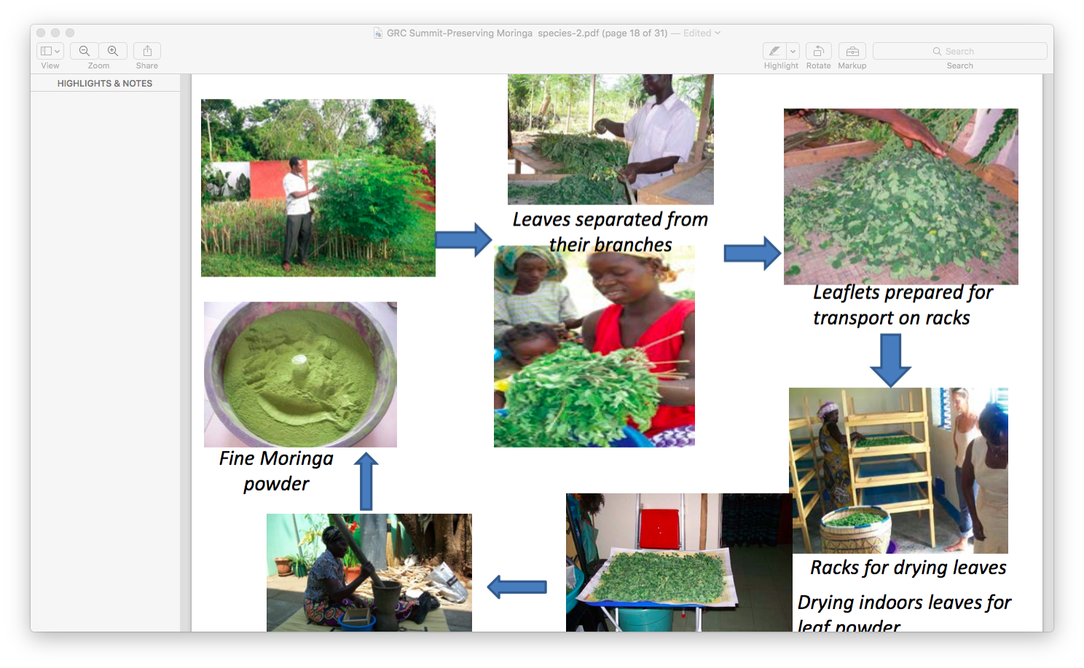
Value Addition
Transformation of raw edible agricultural produce into finished and semi-finished products.

Slide 6
Value Addition
Mutete

Slide 7
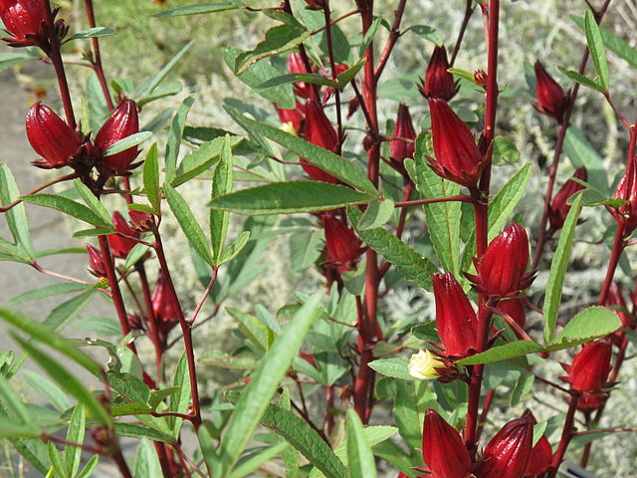
Importance of Indigenous Fruits and Vegetables
They adapt to climate change, and can be…
…used for resilience to the effects of climate change,
…nutrient dense in comparison to currently more utilized ones.

Slide 8
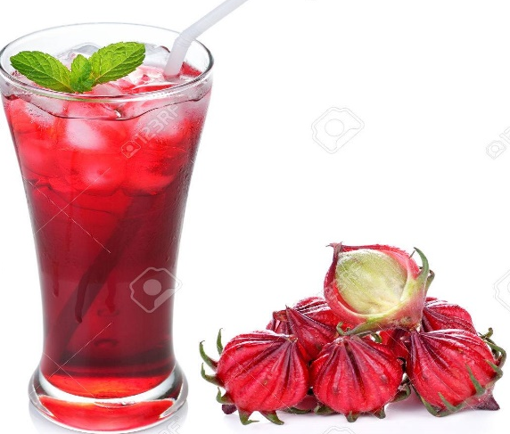
Develop Products from Fruits and Vegetables
Possible products:
Tea, syrups, yoghurts, juice, jams, sweets, frozen vegetable, sauerkrauts etc…

Slide 9
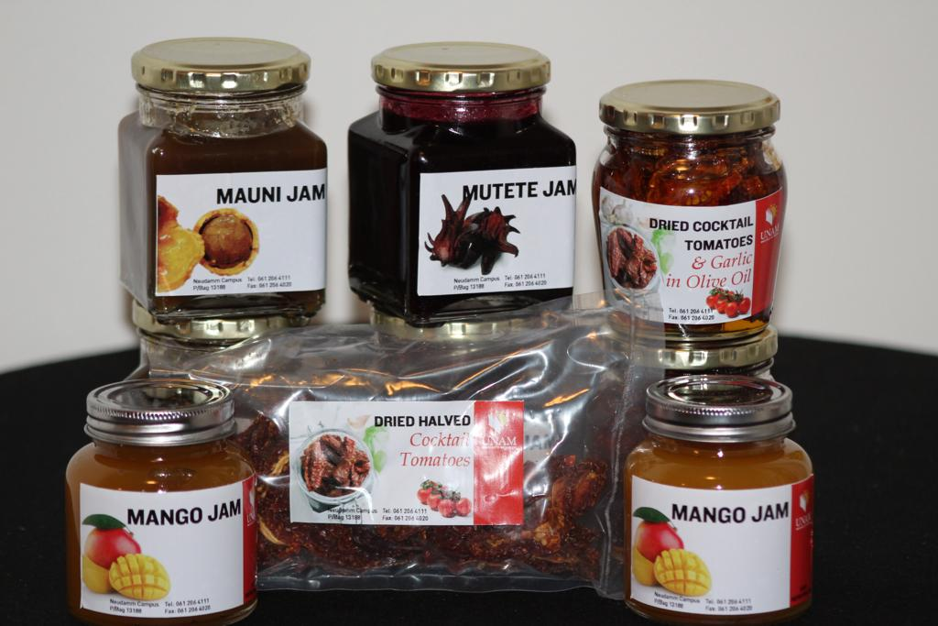
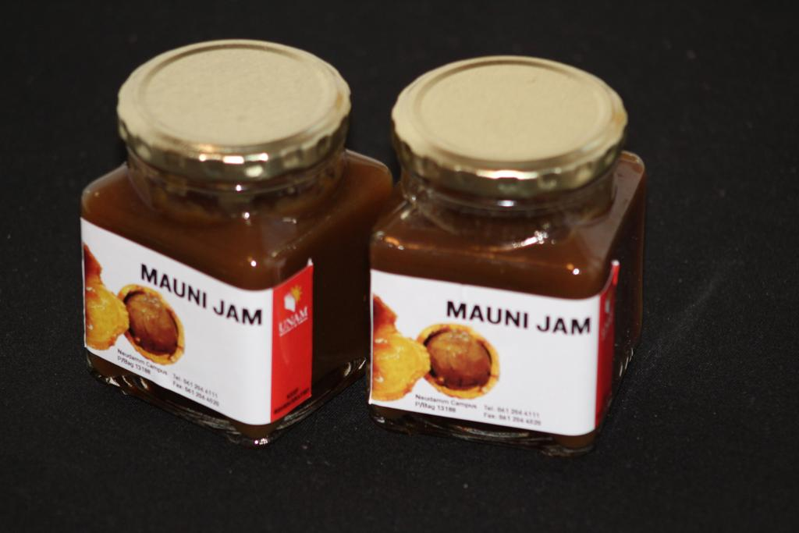
Mutete & Mauni

Slide 10
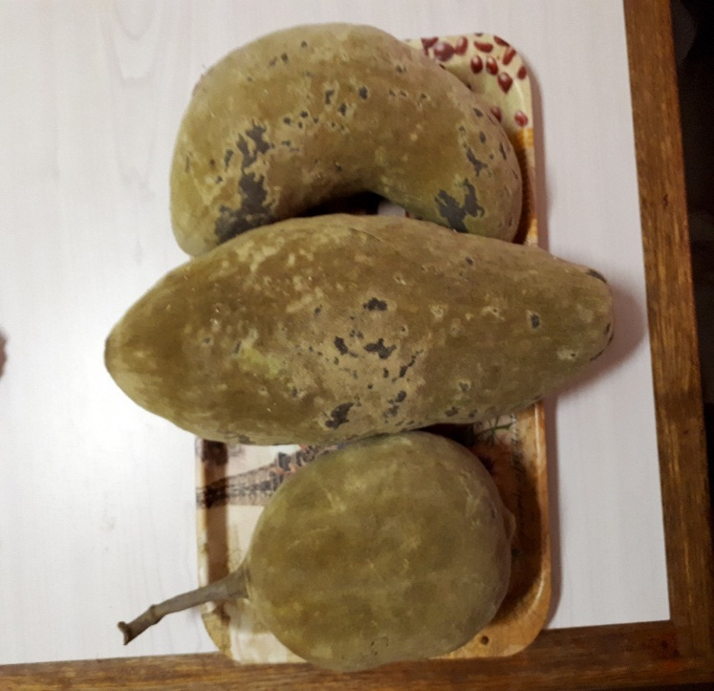
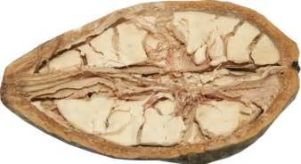
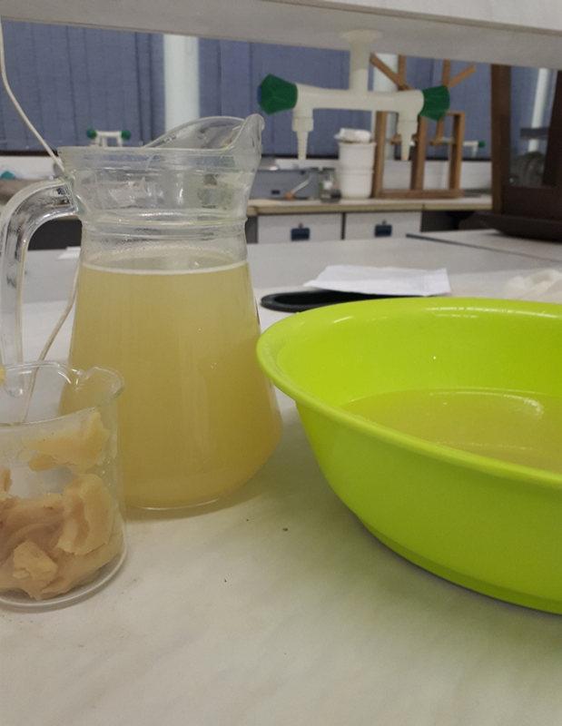
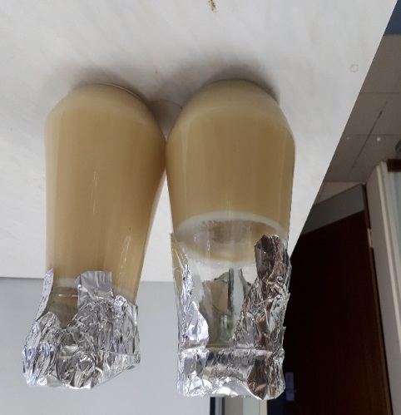
Baobab Fruit Pulp Juice

Slide 11
Kalahari Watermelon

Slide 12
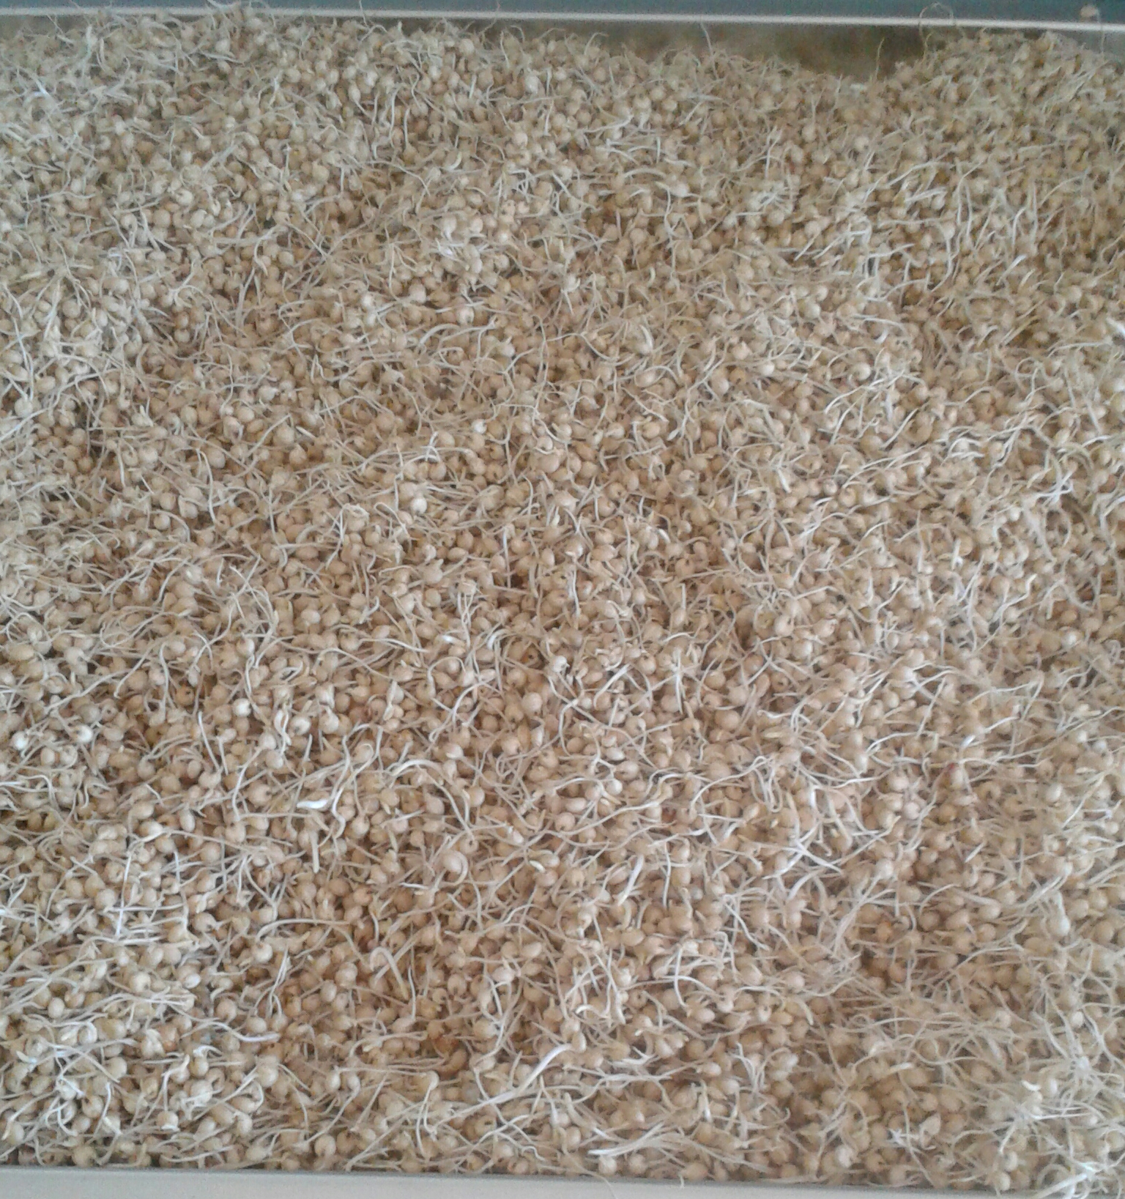
Caffeine Free Sorghum Coffee
+
=
Sorghum Coffee
Diversification of sorghum uses:
Development of Coffee Substitute from
Sorghum and Orange Peels

Slide 13
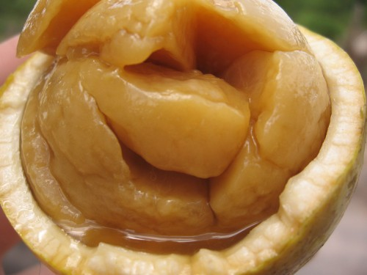
Indigenous Fruit-Brandies:
Ombike

Slide 14
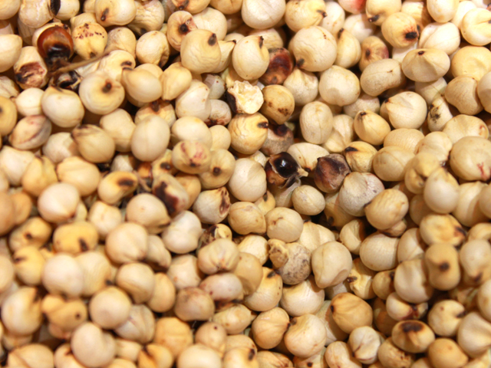
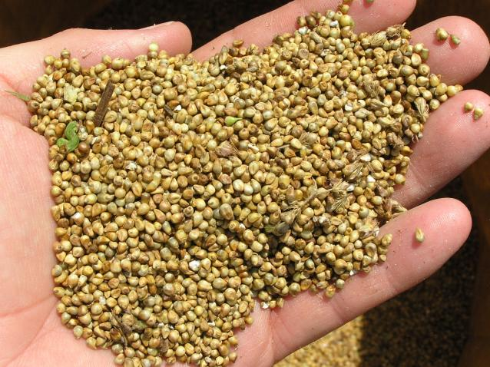
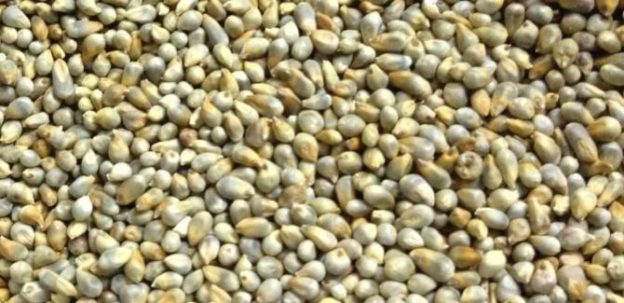
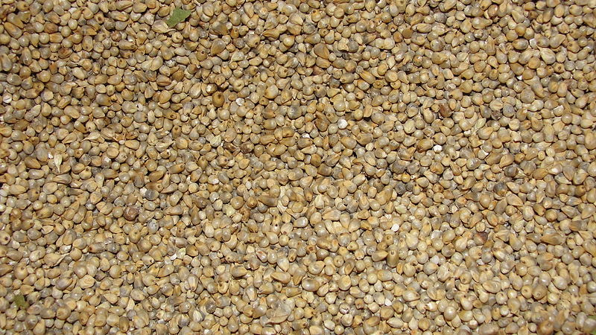
Mahangu Flakes
Macia sorghum
Kantana pearl millet
Kangara pearl millet
Okashana #2

Slide 15
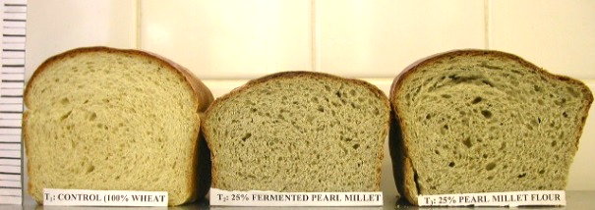
Mahangu: Vetkoeks & Muffins
Prototypes:

Slide 16
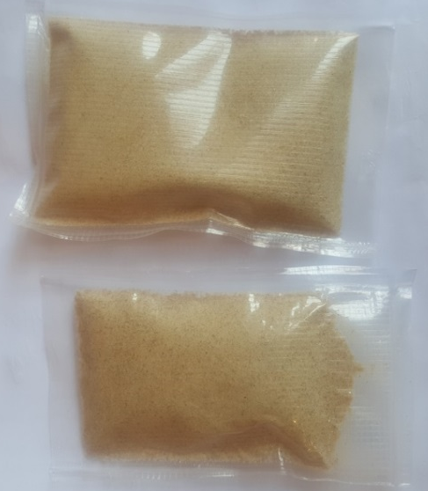
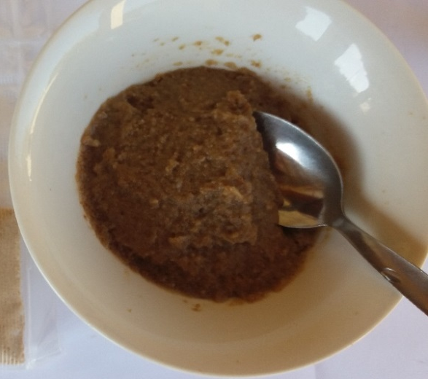
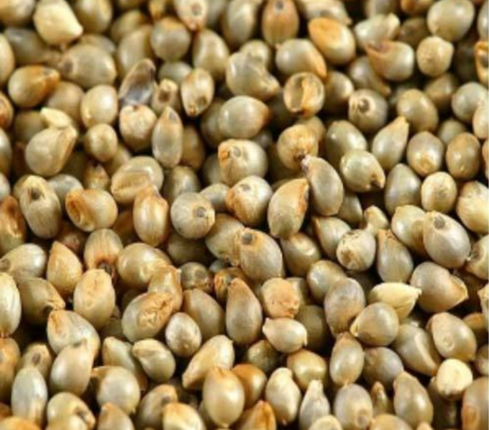
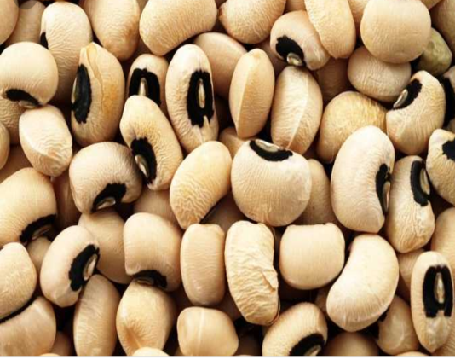
Multidisciplinary Research Center
and Department of Food Science and Technology
.
Mahangu Instant Porridges:
Mahangu and Cowpeas
Mahangu alone
+
Ready-to-eat porridge - Gluten-free & Namibian-made,
with Cowpeas: rich in protein and minerals
Quick-to-make: Just boil water or milk,
add the boiled water while still hot to the flour,
mix to your preferred consistency.

Slide 17
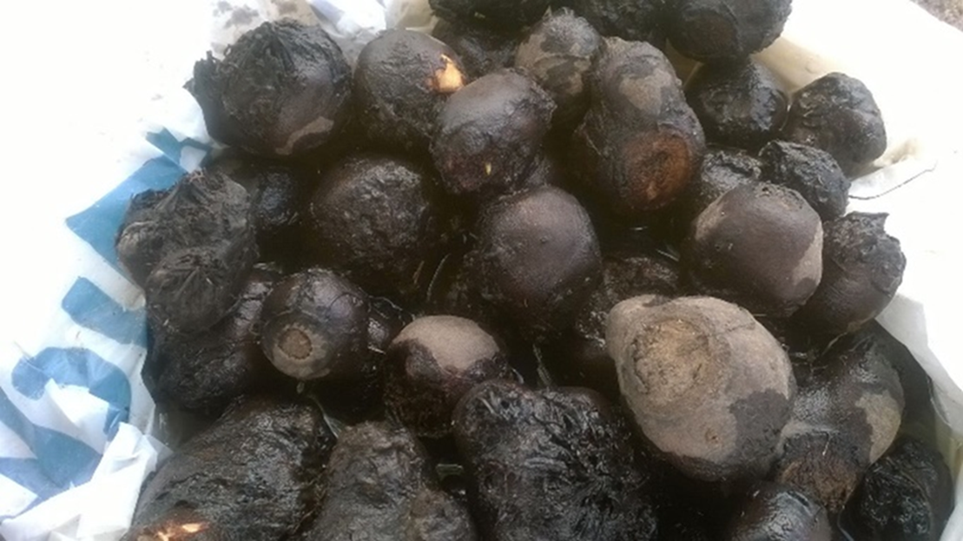
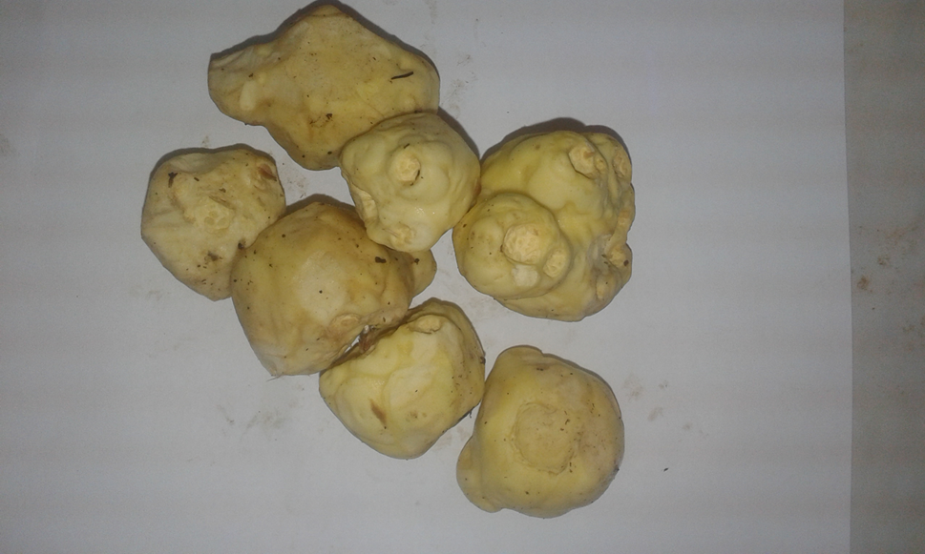
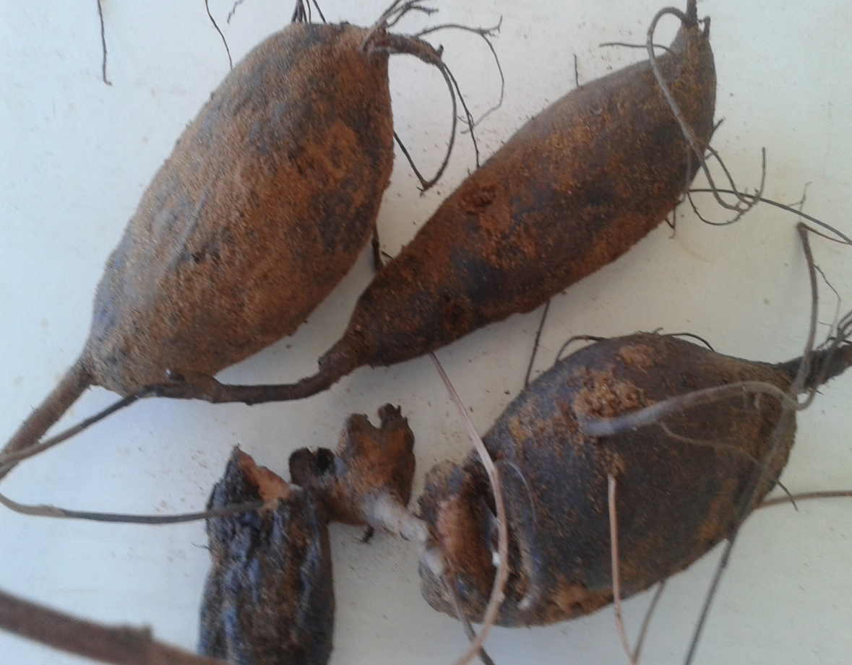
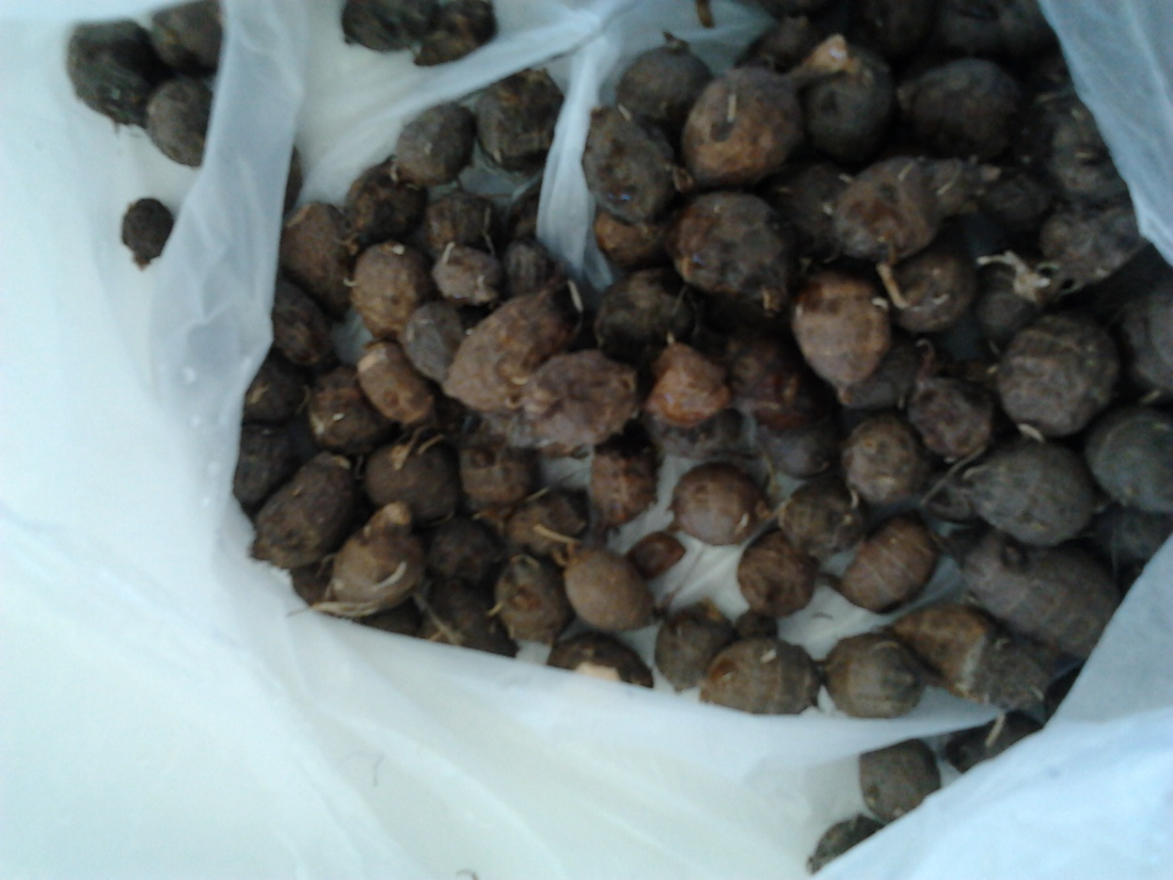
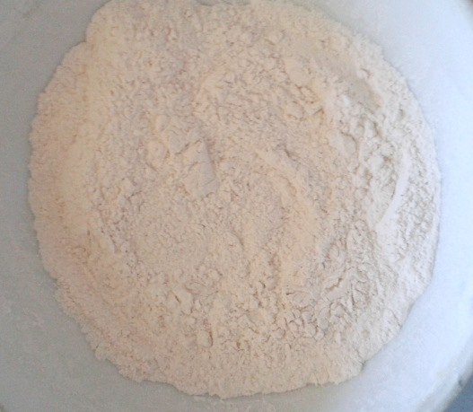
Roots and tubers:
Syrup Ingredients for thickening of Soups
Marama root
Oondago

Slide 18
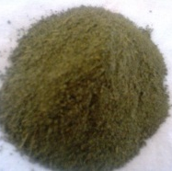
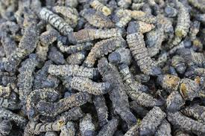
Nutritious Soups, endless possibilities:
Butternut
Carrot
C. Gynandra (ombidi)
Red Pepper
Red
Tomato
Prototype dry premixes
containing Mopane worms
Kuiseb Fishing Enterprise

Slide 19
Waterlily & Hibiscus

Slide 20
Challenges
Not aware of the legal procedures on how they can commercialize their products,
Not aware of food laws to ensure safe products
Others fear exhibiting ideas due to the belief that "Rich people with money" will take their ideas as they know nothing about patents

Slide 21
Challenges
Largely depend on rain-fed agriculture
Affected by erratic weather conditions:
Erratic rains
Recurrent drought
Occasional floods
Outbreak of crops and animal diseases.

Slide 22
Adding Value to our Neglected Plants
Ensures National Food Security & Reduces Vulnerabilities
Reduces Poverty at Community Levels &
Creates Partnerships & Employment for youth, women and rural communities = LOCAL AGRIBUSINESS
Coordination: Research, policy makers, private sector
Allocating Funds: Agro-food processing initiatives
Networking: mutual support, feedback, inspiration

Slide 23
Ni tumezi
Obrigado
Dankie Tog
Mpandu
Thank you
Tangi
Eio
Ke a leboga
Okuhepa
Danke schön

